Slide 1
Studying at Southwest Petroleum University
2023年西南石油大学国际学生招生宣讲会
Energy building a better future

Slide 2
CONTENTS
Part Ⅰ About SWPU
Part Ⅱ Campus life at SWPU
Part Ⅲ Programs for International Students

Slide 3
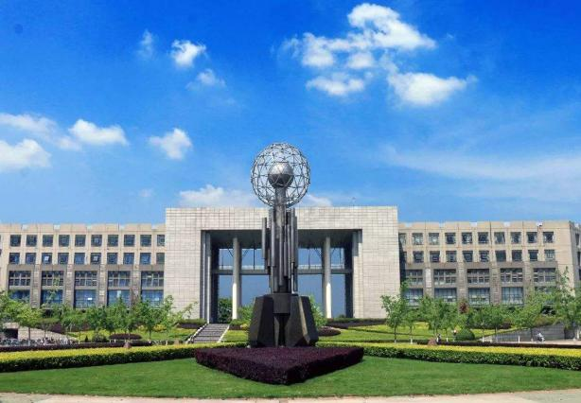
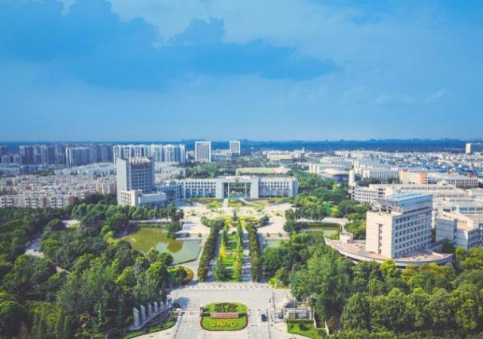
About SWPU
Southwest Petroleum University (SWPU ) - In the west of China
Internationally renowned university
Bridging the gap between tradition and innovation

Slide 4
About SWPU
SWPU located in Chengdu, the capital of Sichuan province
West China
Sichuan Basin, Chengdu plain
20,930,000 inhabitants
a history of over 3000 years
Hometown of Giant Panda
18 embassies and consulates
Nanchong CAMPUS
Chengdu CAMPUS

Slide 5
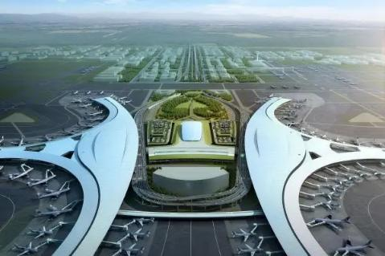
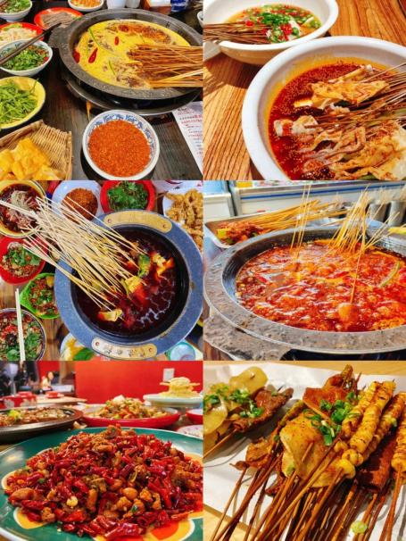
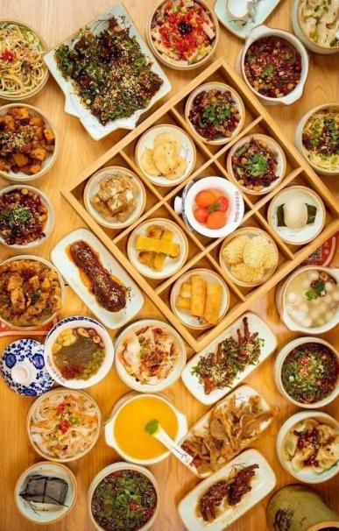
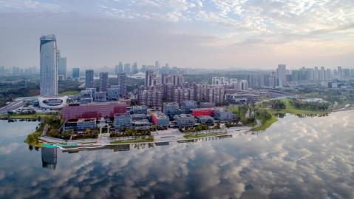
Tianfu Airport, Tianfu New District and Sichuan cuisine

Slide 6
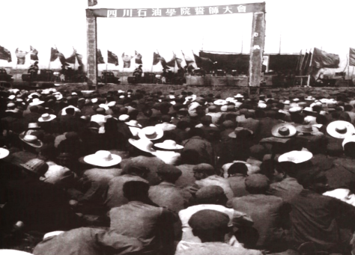
About SWPU
SWPU was founded in 1958 and it’s the second petroleum university in the People’s Republic of China.
Launch the First major battle for oil of the People’s Republic of China
A major battle for oi of Central Sichuan
Establish the second petroleum undergraduate college in the People’s Republic of China
Sichuan Petroleum Institute

Slide 7
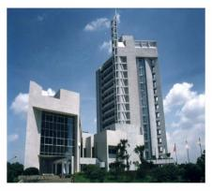
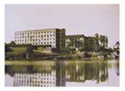
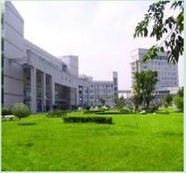
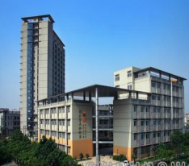
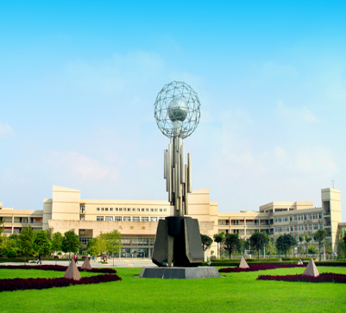
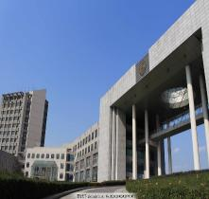
About SWPU
Two campuses
Chengdu Campus： 389 acres
Nanchong Campus：113 acres
Nanchong CAMPUS
Chengdu CAMPUS

Slide 8
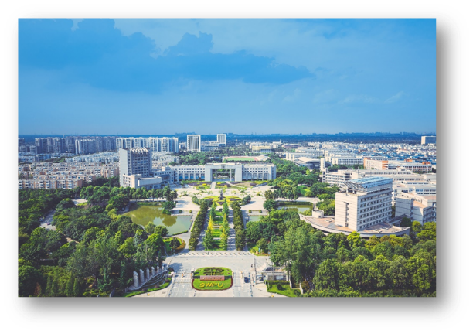
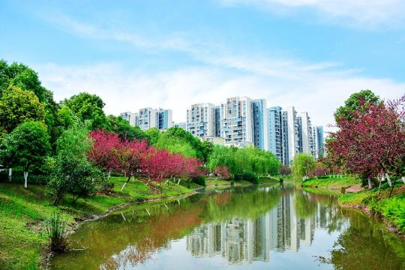
About SWPU
With 65 years of construction, SWPU has grown into a multi-disciplinary university focusing on engineering, with advantage in oil and gas discipline that ranks the top in China.

Slide 9
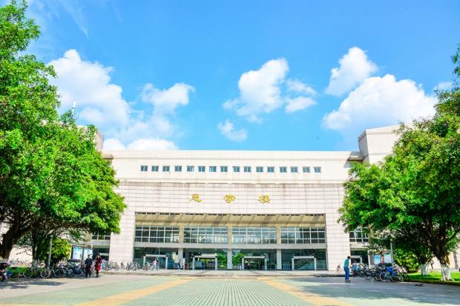
About SWPU
Petroleum and natural gas engineering has been selected as the national first-class discipline for two consecutive rounds, and has been rated as A+ discipline in the national discipline assessment.
The top 1% of ESI ranking disciplines：
Engineering
Chemistry
Material science
Geoscience

Slide 10
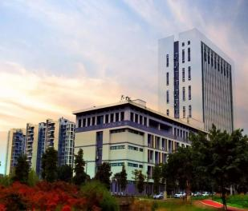
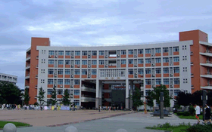
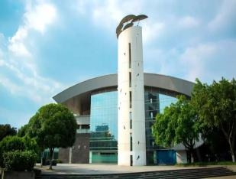
About SWPU
Fifteen schools
School of Petroleum Engineering
School of Geosciences and Technology
School of Mechanical Engineering
School of Chemistry and Chemical Engineering
School of New Energy and Materials
School of Civil Engineering and Geomatics
School of Computer Science
School of Electrical Engineering and Information
School of Sciences
School of Economics and Management
School of Law
School of Marxism
School of Foreign Languages
School of Arts
School of Physical Education

Slide 11
About SWPU
Full-time students: 40,801
31,242 undergraduate students
8,016 master students
1,067 PhD candidates
about 500 international students

Slide 12
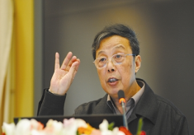
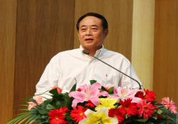
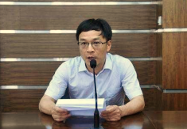
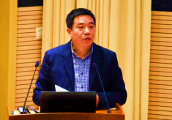
About SWPU
Faculty and staff: 2,814
Full-time professor: 359
Associate professor: 718
LUO PINGYA
ZHOU SHOUWEI
ZHANG LIEHUI
GUO JIANCHUN

Slide 13
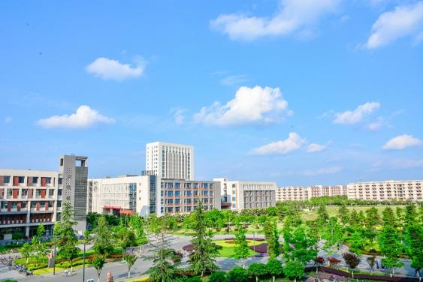
About SWPU
79 undergraduate disciplines, including:
National-level special programs: 8
petroleum engineering
oil gas storage and transportation
resource exploration engineering
exploration technology and engineering
applied chemistry
mechanical engineering and automation
process equipment control engineering
measurement and control technology and instrumentation

Slide 14
About SWPU
A+ Discipline: Oil & Gas Engineering Discipline
89 master's degree disciplines
29 doctoral degree disciplines

Slide 15
About SWPU
2 National Key Laboratories:
National Key Laboratory of Oil and Gas Reservoir Geology and Exploitation
National Key Laboratory of Natural Gas Hydrate

Slide 16
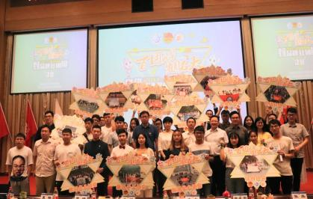
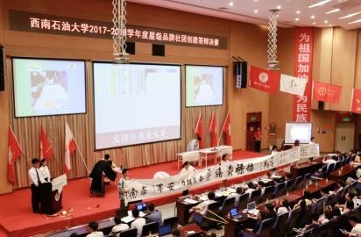
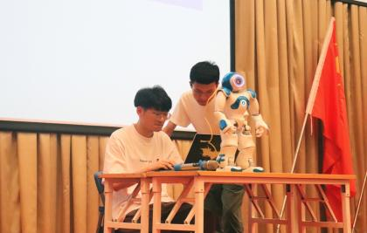
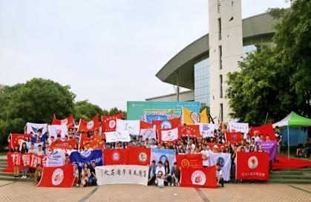
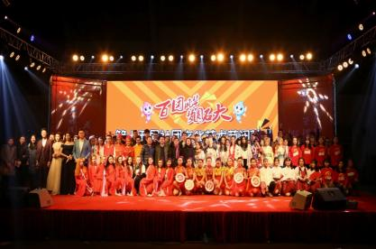
Campus life at SWPU

Slide 17
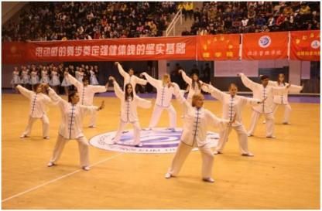
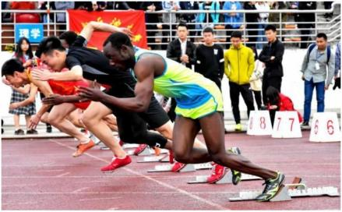
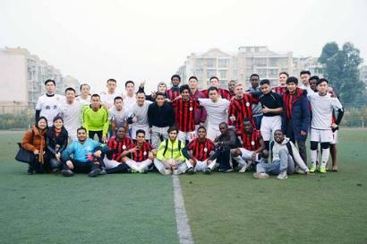
Sports Activities

Slide 18
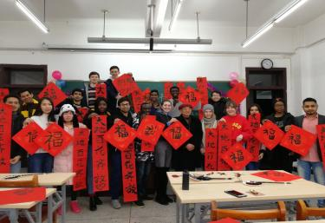
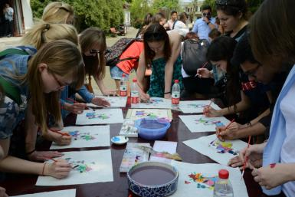
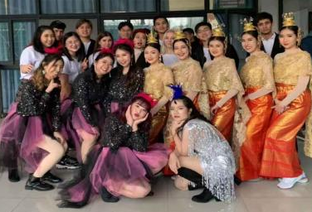
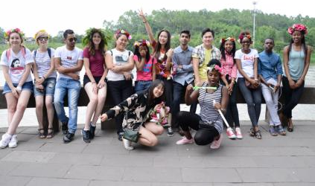
Campus Cultural Activites
The colorful campus life has expanded students' professional knowledge

Slide 19
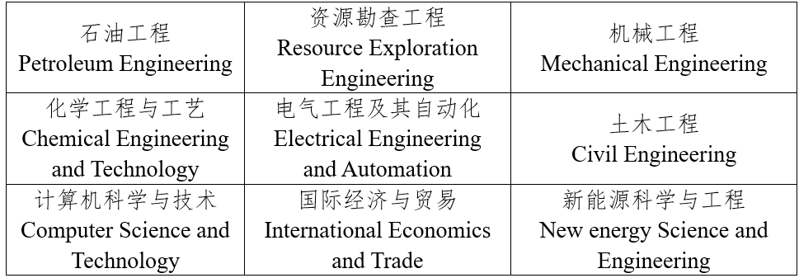
Programs for International Students
9 Bachelor Programs
加拿大加拿大援建唯一天然气勘探开发培训中心
援建唯一加拿大援建唯一天然气勘探开发培训中心
天然气勘探开发培训中心

Slide 20
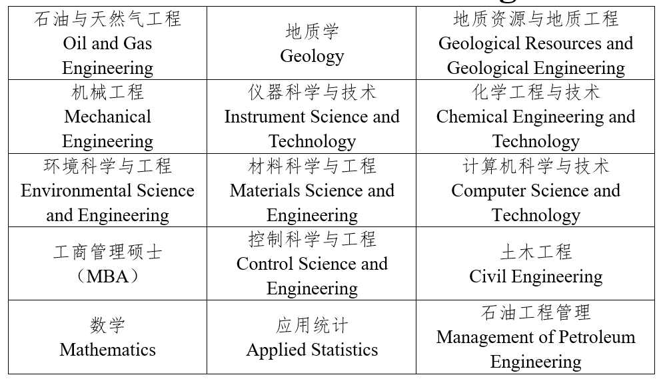
Programs for International Students
15 Master Programs
加拿大加拿大援建唯一天然气勘探开发培训中心
援建唯一加拿大援建唯一天然气勘探开发培训中心
天然气勘探开发培训中心

Slide 21
Programs for International Students
7 PhD Programs
加拿大加拿大援建唯一天然气勘探开发培训中心
援建唯一加拿大援建唯一天然气勘探开发培训中心
天然气勘探开发培训中心

Slide 22
Fees
Tuition | Bachelor students | 8000RMB/Year
 | Master students | 12000RMB/Year
 | PhD students | 20000RMB/Year
Accommodation | 4-2 students’ dormitory | 1600 -3000RMB/Year
Registration | 600 RMB
Insurance | 800 RMB/ Year

Slide 23
Scholarship
Government Scholarship
Sichuan Provincial/
Chengdu Belt and Road/
Chengdu Sister City Scholarship
Bachelor students: 20,000 RMB/ YR
Master students: 25,000 RMB/ YR
PHD students: 30,000 RMB/YR
Study at SWPU Scholarship
Bachelor students: 8,000 RMB/ YR
Master students: 1,200RMB/ YR
PHD students: 20,000 RMB/YR

Slide 24
Admission Guide
Student type | Enrollment Requirement and Application Document
Bachelor Students | Non-Chinese citizens with the age between 18 to 25 who are in good health and willing to abide by Chinese laws and regulations, Southwest Petroleum University rules and regulations, respect Chinese customs, and abide by social ethics; Passport validity shall be more than 2 years; High school degree certificate and transcripts (Certified Chinese or English translations are required for non-English materials; English proficiency certificate （IELTS, TOFEL or certificate of English level of previous degree); NO Criminal Record (validity shall be within 3months); Financial Guarantee (Offered by the bank); Physical Examination Record Foreigner; Other supporting materials, such as certificates of awards, etc.

Slide 25
Admission Guide
Student type | Enrollment Requirement and Application Document
Master Students | Non-Chinese citizens under the age of 35 who are in good health and willing to abide by Chinese laws and regulations, Southwest Petroleum University rules and regulations, respect Chinese customs, and abide by social ethics Passport validity shall be more than 2 years。 Bachelor degree certificate and transcripts (Certified Chinese or English translations are required for non-English materials); English proficiency certificate （IELTS, TOFEL or certificate of English level of previous degree); Research Plan ( Chinese/English, at least 1500 words); 2 Recommendation Letters (Referrers should have title of professor or associate professor); NO Criminal Record (validity shall be within 3months); Financial Guarantee (Offered by the bank); Physical Examination Record for Foreigner; Other supporting materials, such as certificates of awards, etc.

Slide 26
Admission Guide
Student type | Enrollment Requirement and Application Document
PhD Students | Non-Chinese citizens under the age of 40 who are in good health and willing to abide by Chinese laws and regulations, Southwest Petroleum University rules and regulations, respect Chinese customs, and abide by social ethics; Passport validity shall be more than 2 years; Master and PhD degree certificate and transcripts (Certified Chinese or English translations are required for non-English materials); English proficiency certificate （IELTS, TOFEL or certificate of English level of previous degree); Research Plan ( Chinese/English, at least 1500 words); 2 Recommendation Letters (Referrers should have title of professor or associate professor); NO Criminal Record (validity shall be within 3months); Financial Guarantee (Offered by the bank); Physical Examination Record for Foreigner; Other supporting materials, such as certificates of awards, etc.

Slide 27
CONTACT US
WEBSITE: https://www.swpu.edu.cn
TEL: 0086-86-83032846
E-mail: admissions_swpu@qq.com
Application link：
https://swpu.17gz.org/
Come to China, Study at SWPU!

Slide 28
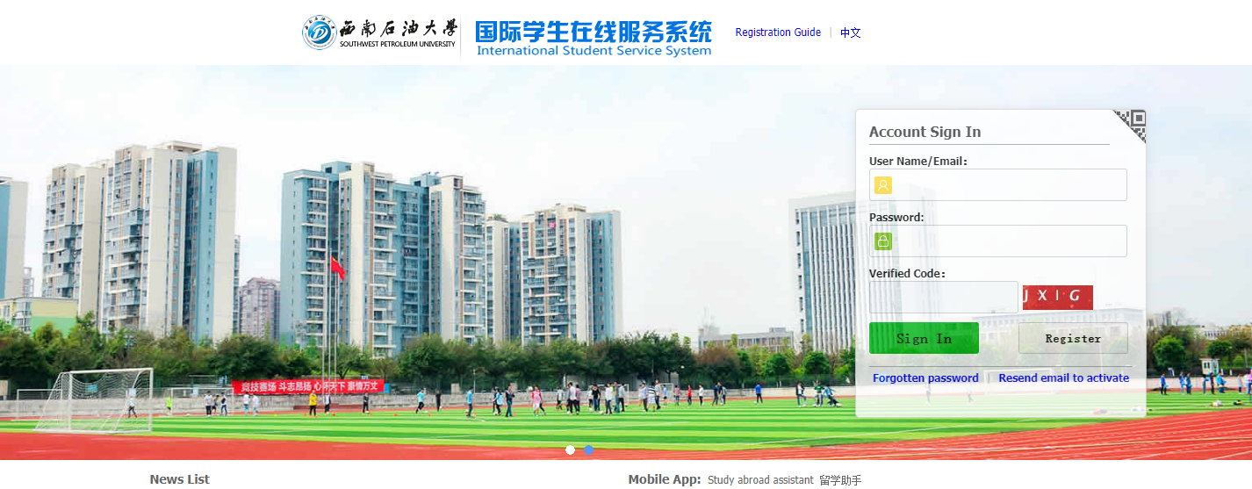
CONTACT US
https://swpu.17gz.org/

Slide 29
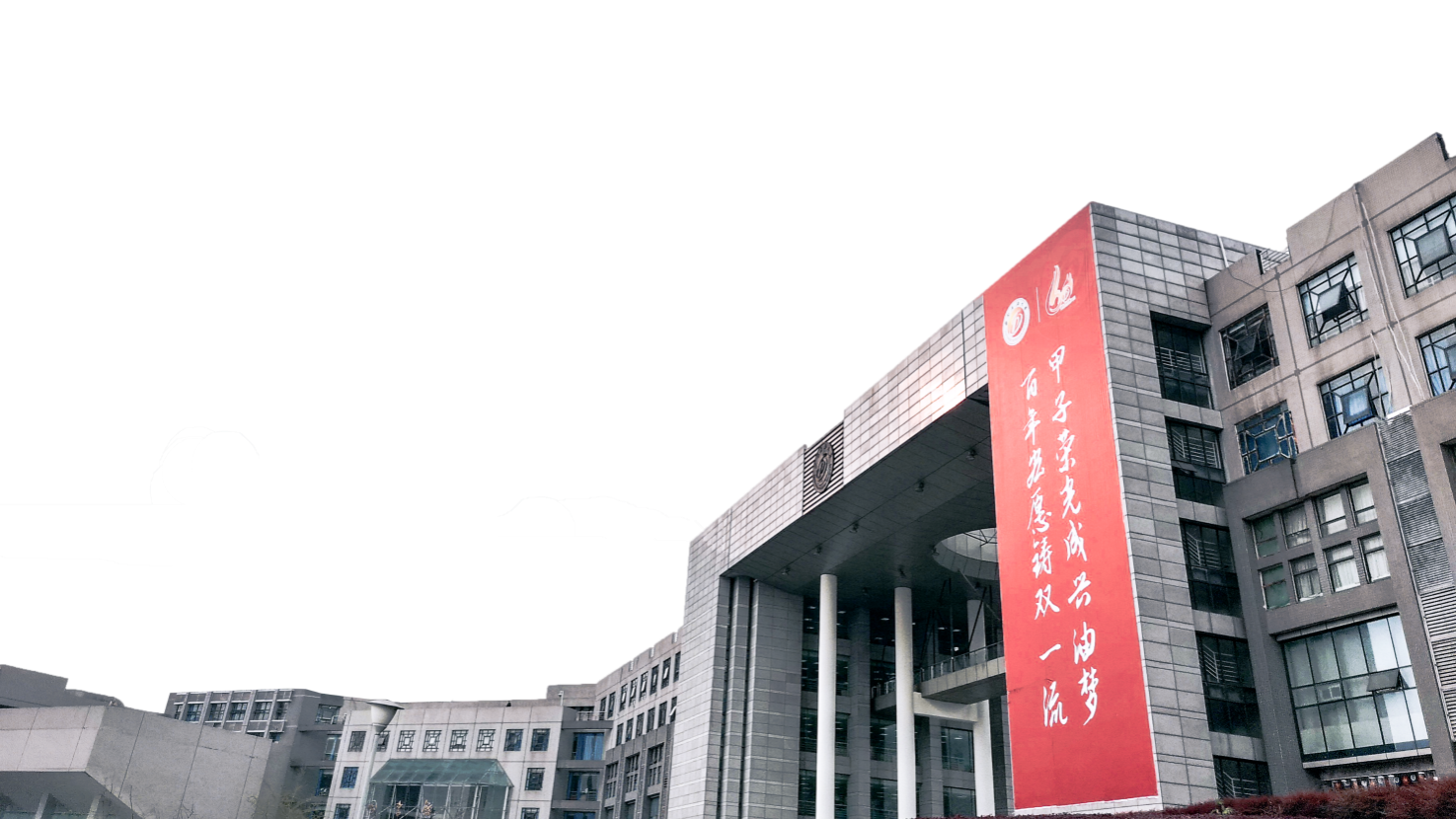
Looking forward to seeing you at SWPU!

